Slide 1
ORLJ 4009-Session 1.0
Understanding Behavioral Research
Madhabi Chatterji, Ph.D.
Professor of Measurement, Evaluation and Education
Director, Assessment and Evaluation Research Initiative (AERI)
Teachers College, Columbia University

Slide 2
AGENDA
Introductions, syllabus, housekeeping...Q & A
Exploration: What is Research?
  Hallmarks of Scientific Research -- “Disciplined Inquiry” Processes
  Basic Research vs. Applied Research, Field Research
  Conclusion-oriented vs. Decision-oriented Research
Research and Evidence-based Practice (EBP)
Types of Research Designs—A Continuum tied to
Research Questions (Quant., Qual., Mixed-methods Designs)
Practice Exercise
Readings from both Sekharan & Bougie and Cresswell textbooks

Slide 3
What is ORLJ 4009 About?
Provides an overview of major research methods useful in designing and executing studies in applied fields like business, education, psychology, health /mental health, and other social science areas
Main purpose:
To help participants become informed and critical consumers of published research articles/reports that employ :
  Quantitative research designs
  Qualitative research designs
  Mixed-methods and multi-method designs.

Slide 4
Understanding Behavioral Research
What is Research?
Your Thoughts and
Examples

Slide 5
Research Questions-Examples
Business -Research Problem: To what extent do different types of company ownership (state-owned, publicly –traded, private) in the offshore drilling industry, lead to different growth rates ?
Education- Research Problem: Does a curriculum-related technology resource (e.g., Canvas) lead to higher student achievement levels in different institutions (public, private, charter schools)?
Women’s Studies- Problem: In what ways do women in a psychology doctoral program describe their decision-making processes to return to school after motherhood? How do they characterize their reentry experiences and factors that maximized their successes in graduate school? What are their degree completion rates?

Slide 6
What is Research?
Research is a form of:
“Disciplined Inquiry” –Cronbach & Suppes (1969)
The systematic use of social research methods to examine a problem that has some larger social, practical and/or theoretical significance
  Purposeful
  Data–based
  Credible, replicable (testable) and defensible (holds up when subjected to objective scrutiny by other scholars/experts in a discipline or field of study)
  Ethical
[using accepted definitions and standards for “rigor”
in the particular discipline or field of study]
NOTE: Research could be conducted in laboratory, natural, organizational/community (field) settings

Slide 7
What is Business Research?
Sekharan & Bougie (2016)
Organized, systematic, data-based, critical, objective, inquiry or investigation into a specific problem, in search of answers or solutions.
  Applied Research –solving current problems situated in work settings with systematic research
  Basic Research (Fundamental or pure research)– generate a body of new knowledge that adds to the discipline or field of study
Manager-initiated research (within ornaizations)
Consultant-researchers

Slide 8
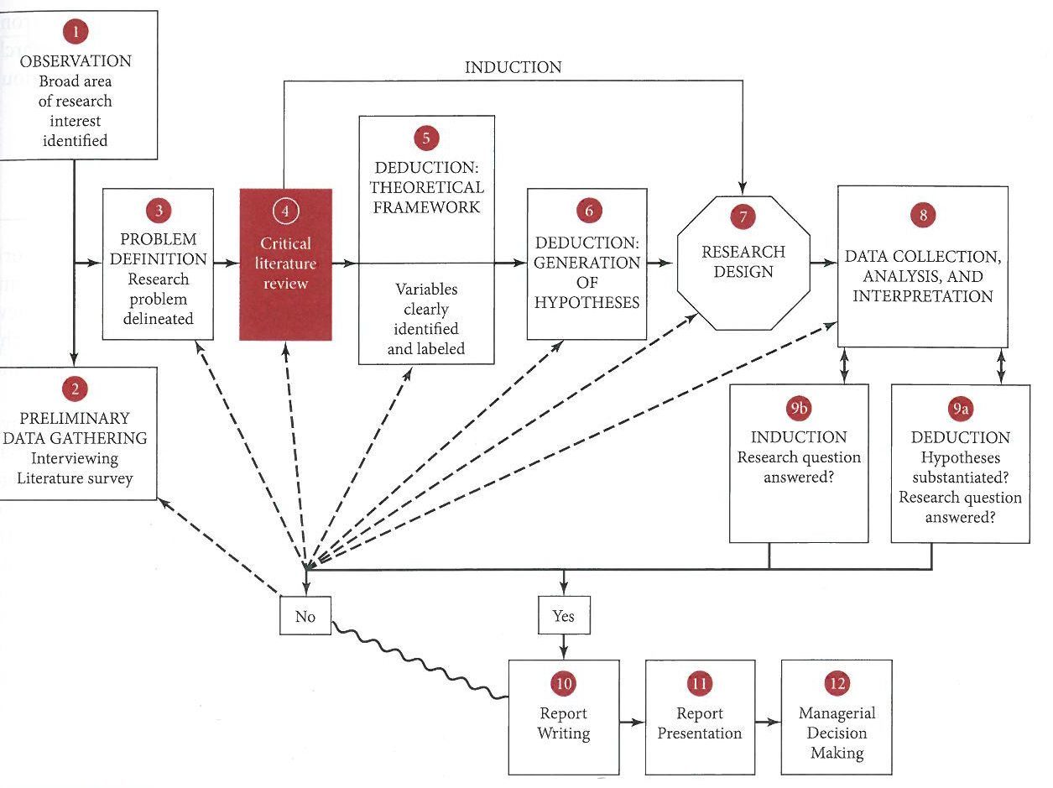


Slide 9
Two Broad Types of Research per Cronbach & Suppes (1969) [see highlighted section of the article posted by Alkin]
1. Conclusion-oriented inquiry
Conducted for the purposes for adding to the formal and theoretical knowledge-base in a domain or discipline of study ( e.g., physics, psychology, education, business, health).
Primary Goal: Theory development, theory verification, knowledge-production in a field
Basic or Fundamental Research falls under this category; Also, “Field Research” in some disciplines

Slide 10
Two Broad Types of Research per Cronbach & Suppes (1969) [see highlighted section of the article posted by Alkin]
2. Decision-oriented inquiry
-Conducted for the purposes for solving an applied problem in organizations or communities that is of some larger social or practical significance
-Informs decision-making needs of professionals, practitioners, or policy-makers in organizations or communities
-New knowledge production may occur ( relevant to fields of psychology, education, business, health, etc.). , but is typically not the primary purpose driving the research.
Primary Goal: Inform actions and decisions in organizations or communities
(includes Applied Research and Field Research, as well as,
“Evaluation Research” or Program Evaluation in public sector organizations)

Slide 11
What are “Research Methods”?
“Research Methods”:
Speak to how the research is carried out by researchers -
The application of systematic approaches, use of particular tools of inquiry, and strategies for gathering and analyzing different kinds of data to investigate, and gain deeper understandings of a problem.
  Quantitative study designs
  Qualitative study designs
  Mixed-methods or multi-method study designs

Slide 12
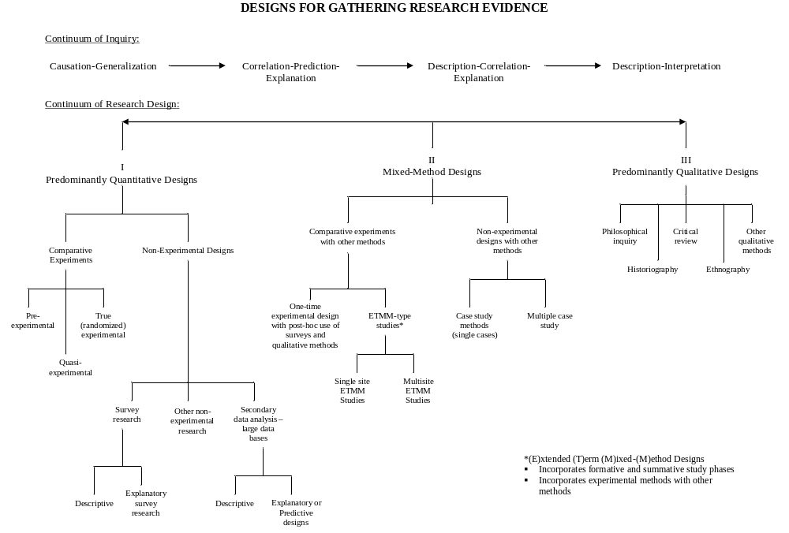

Slide 13
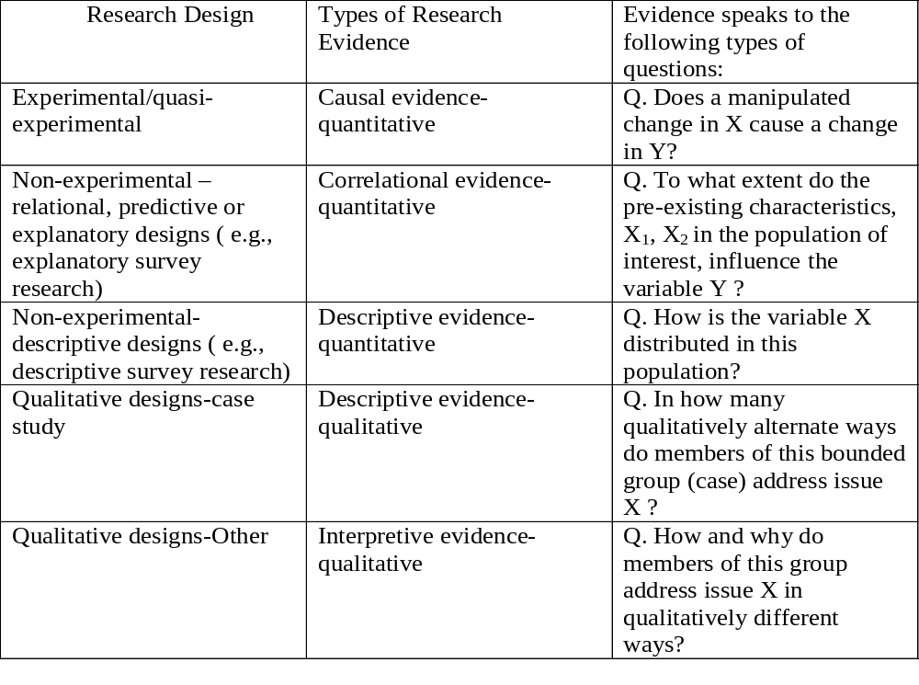

Slide 14
Different Research Methods are best equipped to answer different Research Questions
Think of: Hammers vs. Saws !
The research methods/tools of inquiry on the study design continuum are best applied for answering different types of research questions
  Cause-effect questions
  Relational (correlational), predictive and explanatory questions
  Descriptive questions
  Exploratory questions
  Critical-interpretive questions

Slide 15
Mixed–Methods (MM) Designs
Creswell & Creswell (2018)
Convergent, Parallel MM designs
Sequential MM designs—explanatory or exploratory
Complex MM designs
( Pragmatist philosophy: combining philosophical foundations on how knowledge is produced from quantitative and qualitative research designs traditions)

Slide 16
What is Evidence-based Practice (EBP)?
EBP is using research-based evidence to inform, deliver, and improve services/practices in a field
  E.g. EBP question on Employee Assistance Services
What does the body of published research tell us about whether, and how well, Employee Assistance Services work in preventing staff turnover in corporations?
Key issue for EBP: What is the quality of research-based evidence on this topic? What kind of study designs were used researchers? Were studies executed well?

Slide 17
Homework Activity
1. Based on your readings, provide an example of:
  A basic research study
  An applied research study
  A field research study
Justify your answer.
2. Look at an abstract of a published study in your field of interest. Are researchers using mostly quantitative, qualitative or mixed methods approaches?
Key concepts:
Hallmarks of sound research; applied research, basic research, conclusion-oriented and decision-oriented inquiry; Evidence Based Practice (EBP), continuum of study designs vs research questions

